Slide 1
ELD Retelling Cards
The E-mail Pals

Slide 2
STANDARD
Emerging, Expanding, and Bridging
A. Collaborative: Exchange information and ideas with others through oral collaborative discussions.
B. Interpretive: Listening actively to spoken English
C. Productive: Expressing information and ideas in formal oral presentations

Slide 3
Language Objective
I CAN RETELL A STORY BY WRITING ABOUT MY FAVORITE PART OF THE STORY.

Slide 4
CONNECT TO PRIOR KNOWLEDGE
Who remembers Stella Luna?
Who can tell me what their favorite part of that story was? Think/Pair/Share

Slide 5
Language OBJECTIVE
I CAN RETELL A STORY BY WRITING ABOUT MY FAVORITE PART OF THE STORY.

Slide 6
INPUT
Step to retelling
1. Listen to the teacher read the story.
2. The teacher will read a question.
3. Use a complete sentence to answer the question. Use the sentence frame to help you answer the question.

Slide 7
MODEL
I do the work, you listen!

Slide 8
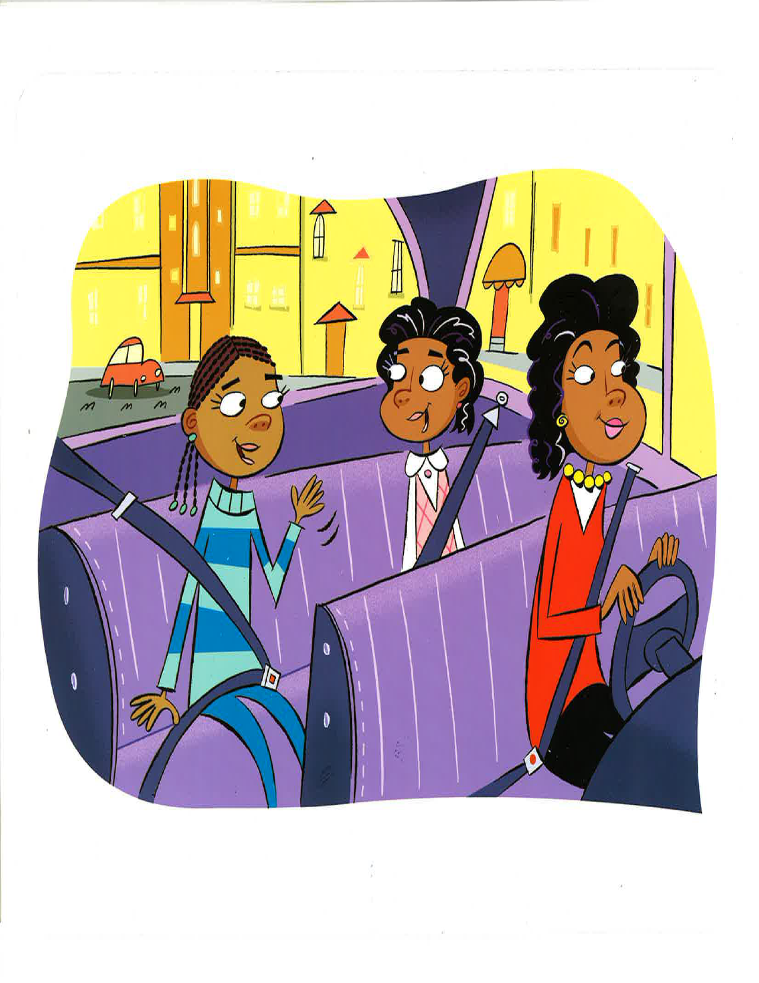
1. Listen to the teacher read the story.
2. The teacher will read a question.
3. Use a complete sentence to answer the question. Use the sentence frame to help you answer the question.
Level 1-2: Gina and Tyra are going ____________. Gina and Tyra__________________________
Level 3: Gina’s mom is taking Gina and Tyra ___________________________.
Level 4: _____________________are in the car. I go with friends ______________________

Slide 9
STRUCTURED PRACTICE
Let’s do this together!

Slide 10
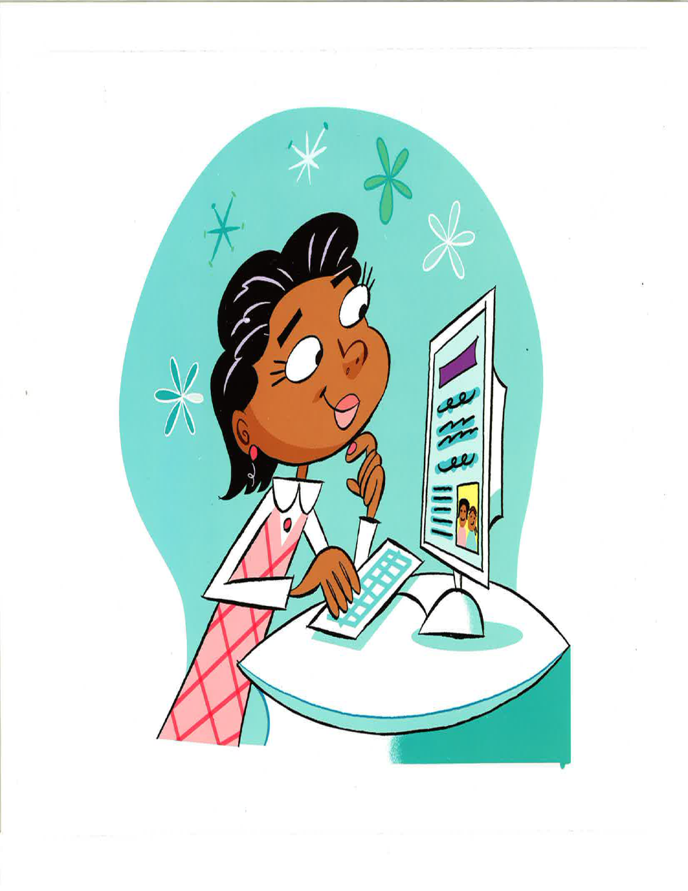
1. Listen to the teacher read the story.
2. The teacher will read a question.
3. Use a complete sentence to answer the question. Use the sentence frame to help you answer the question.
1. Gina is looking at_____________________________________. 2. I send e-mails to___________________________.
3. Gina is_________________________. Tyra sent Gina _____________________________.

Slide 11
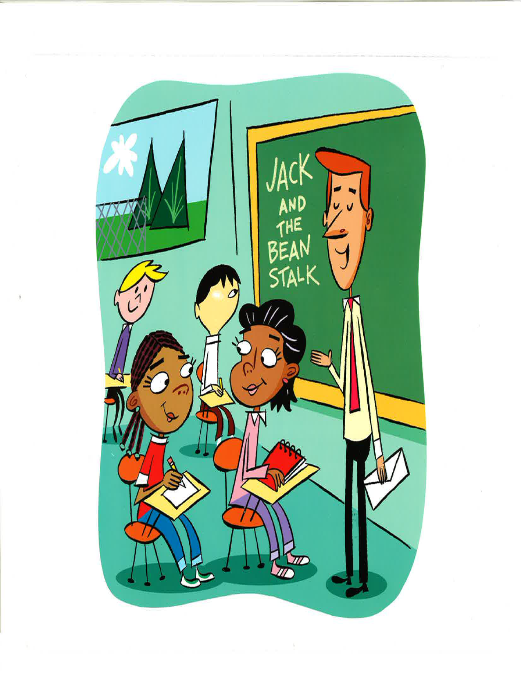
1. Listen to the teacher read the story.
2. The teacher will read a question.
3. Use a complete sentence to answer the question. Use the sentence frame to help you answer the question.
1. Gina is _____________________________________. 2. The teacher is telling the class___________________________.
3. Gina and Tyra are _____________________________________.

Slide 12
Language OBJECTIVE
I CAN RETELL A STORY BY WRITING ABOUT MY FAVORITE PART OF THE STORY.

Slide 13
GUIDED PRACTICE
Time to work with your partner. You will do it with support.

Slide 14
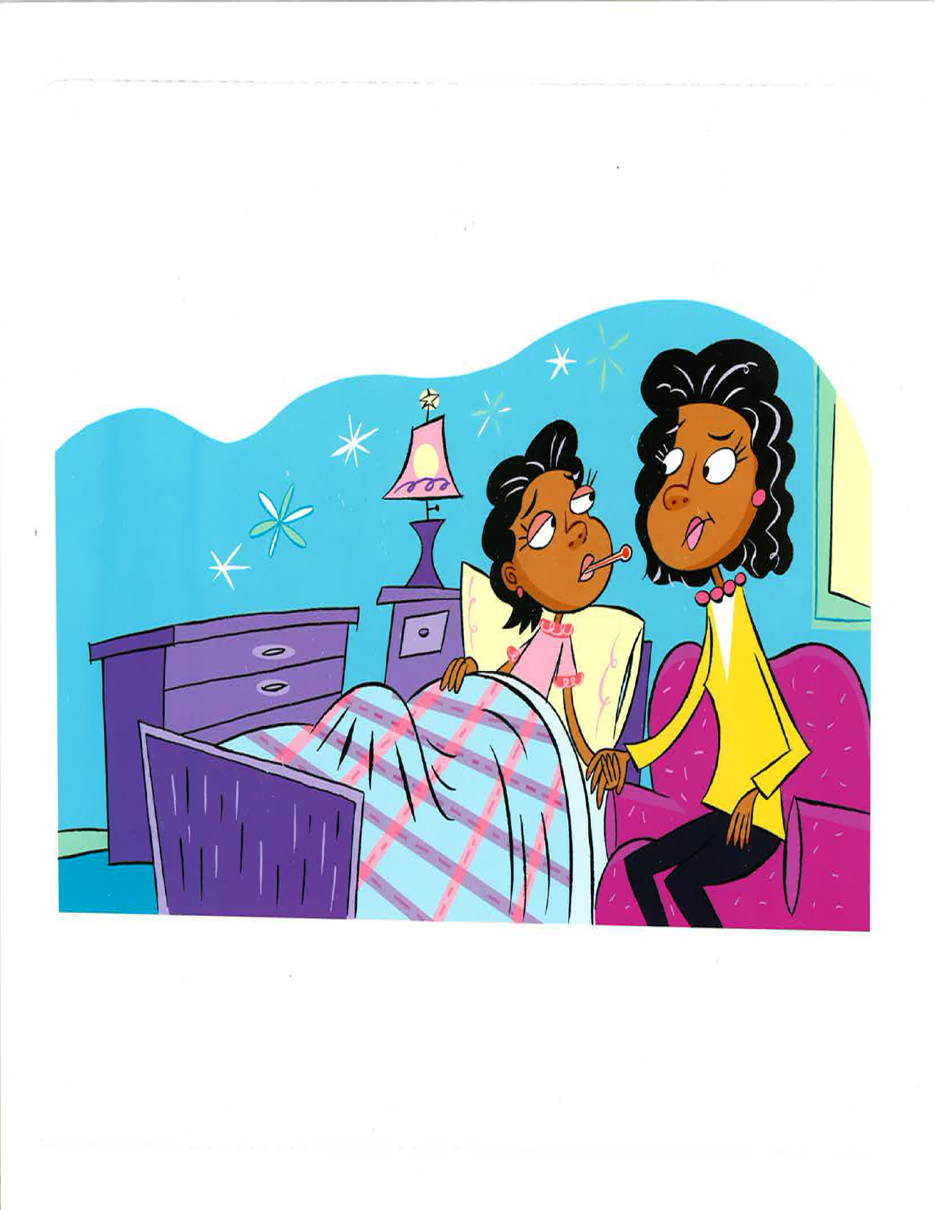
1. Listen to the teacher read the story.
2. The teacher will read a question.
3. Use a complete sentence to answer the question. Use the sentence frame to help you answer the question.

Slide 15
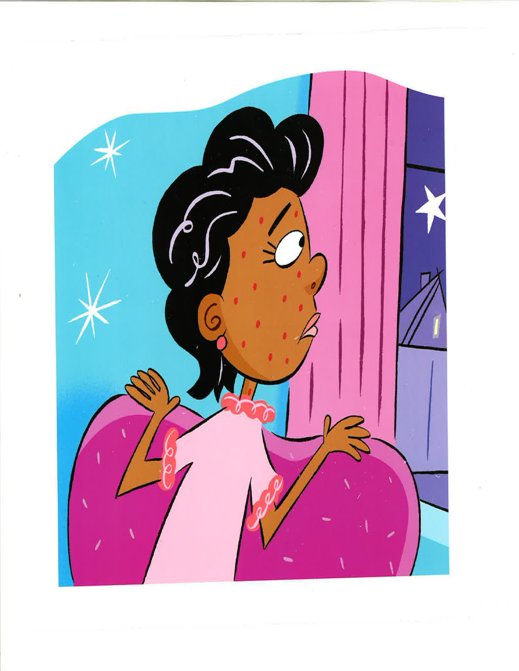
1. Listen to the teacher read the story.
2. The teacher will read a question.
3. Use a complete sentence to answer the question. Use the sentence frame to help you answer the question.

Slide 16
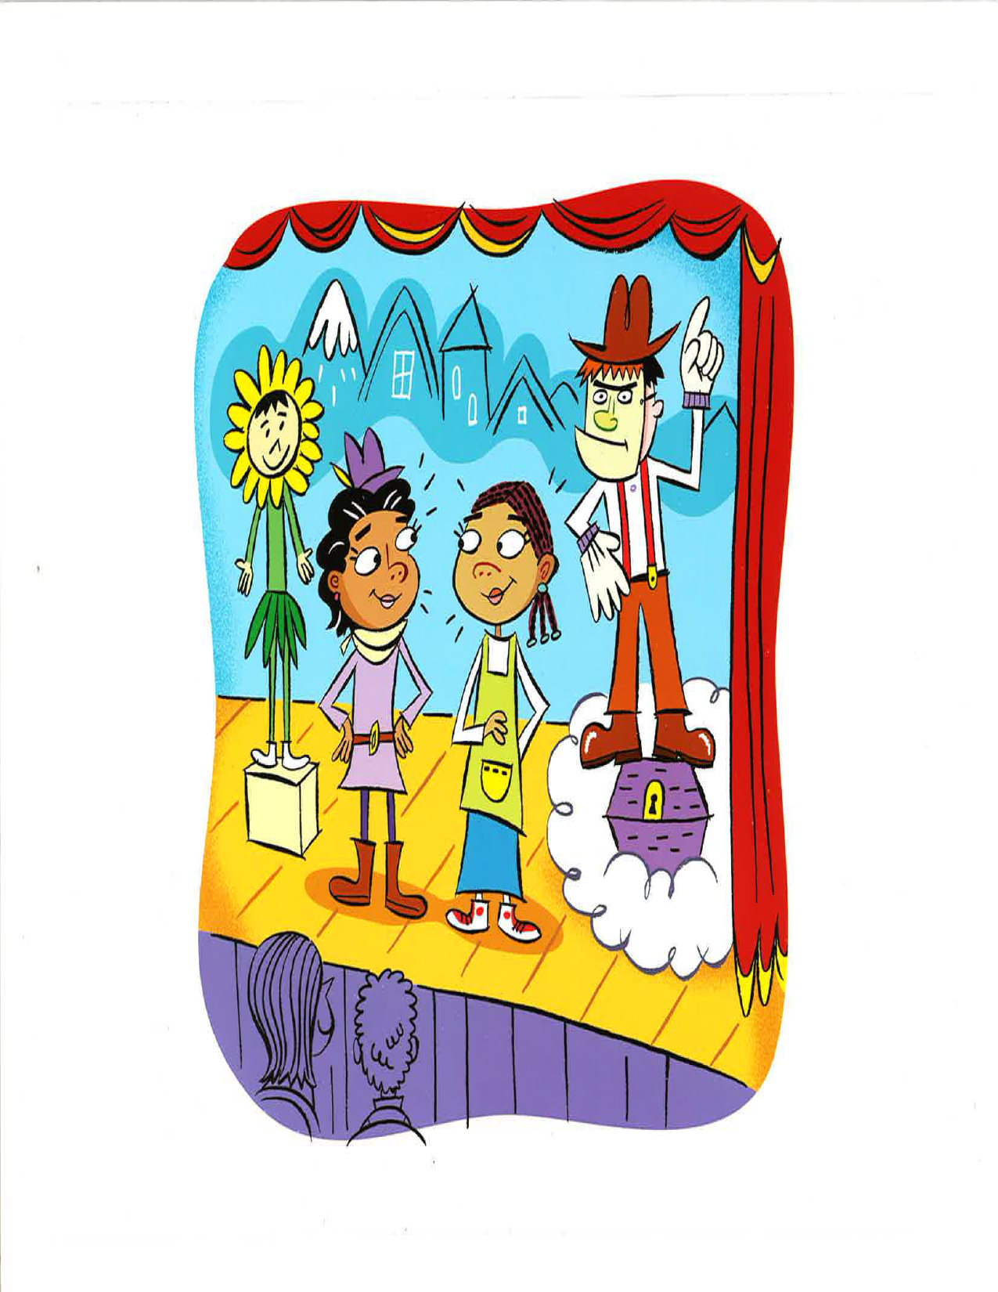
1. Listen to the teacher read the story.
2. The teacher will read a question.
3. Use a complete sentence to answer the question. Use the sentence frame to help you answer the question.

Slide 17
STANDARD
Emerging, Expanding, and Bridging
A. Collaborative: Exchange information and ideas with others through oral collaborative discussions.
B. Interpretive: Listening actively to spoken English
C. Productive: Expressing information and ideas in formal oral presentations

Slide 18
Language OBJECTIVE
I CAN RETELL A STORY BY WRITING ABOUT MY FAVORITE PART OF THE STORY.

Slide 19
INDEPENDENT PRACTICE
Write about your favorite part of the story. Be prepared to retell your favorite part of the story.

